Slide 1
Devon Dive Adventures

Slide 2
Requirements
The brief explained that the website should:
One way of doing this is by including simple details of the activities to hook their interest on the home page
Inform the potential customers of Devon Dive Adventures activities available

Slide 3
Requirements
The Colour Scheme
The colour scheme of the website is Navy Blue and Orange
These colours are closely associated with aquatic-related activities in the public eye

Slide 4
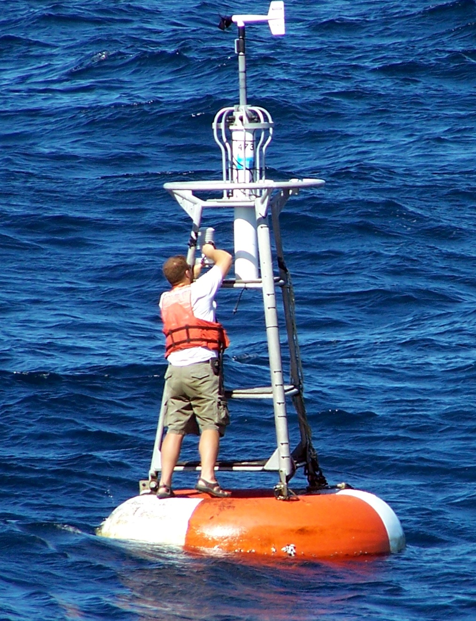
Requirements
The Colour Scheme
Many oceanic pieces of equipment such as life jackets or buoys are coloured orange or a closely associated colour

Slide 5
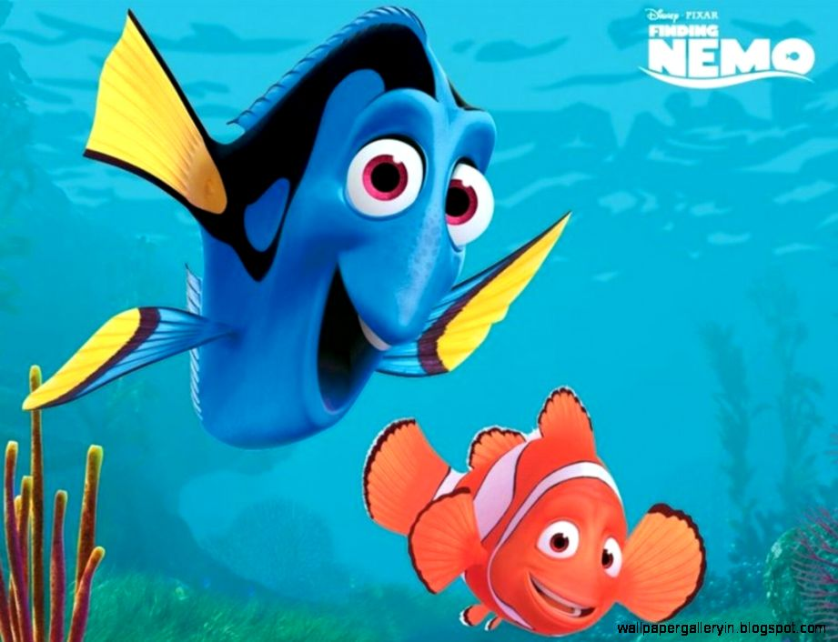
Requirements
The Colour Scheme
The 2 colours are often paired with aquatic life in various media, such as Disney Pixar’s Finding Nemo.

Slide 6
Requirements
The Colour Scheme
We could also change the shade of navy blue to get darker the further down you scroll.
This would give the website a more lively and better sub nautical feeling atmosphere.

Slide 7
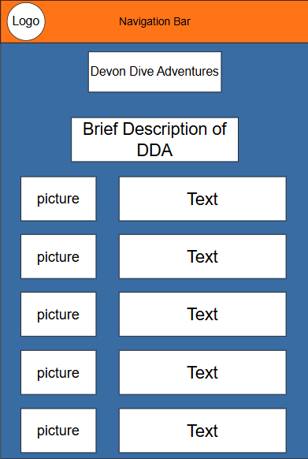
Design Decisions
Home Page
The page should provide a brief description of the company, including its business aims and goals.
As mentioned previously, there should be simple details of the activities to hook their interest and link to the activities page.

Slide 8
Design Decisions
Home Page
The page should provide a brief description of the company, including its business aims and goals.
As mentioned previously, there should be simple details of the activities to hook their interest and link to the activities page.

Slide 9
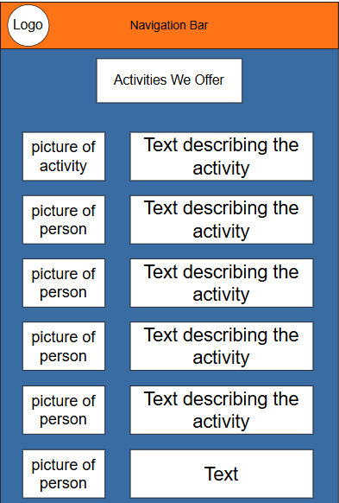
Design Decisions
Activities Page
The Page will have images of the activities on the left side (with alt text).
The right side will have the descriptions and information on that activity.

Slide 10
Design Decisions
Activities Page
The Page will have images of the activities on the left side (with alt text).
The right side will have the descriptions and information on that activity.

Slide 11
Design Decisions
Activities Page
As humans we are naturally drawn to visual information before written information
As well as this, most languages read and write from left to right, so we generally start looking at something from the left.

Slide 12
Design Decisions
Activities Page
As humans we are naturally drawn to visual information before written information
As well as this, most languages read and write from left to right, so we generally start looking at something from the left.

Slide 13
Design Decisions
Activities Page
This heavily influenced the layout of the activities page so the pictures would be displayed on the left as a visual hook and then the description comes after you’ve seen the image.

Slide 14
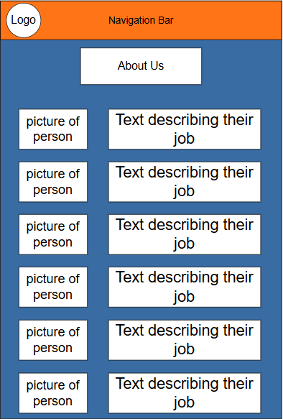
Design Decisions
Design Decisions
About Us Page
This page is structured very similarly to the previous page.
The descriptions simply talk about that person, their background and their role within the company.

Slide 15
Design Decisions
About Us Page
This page is structured very similarly to the previous page.
The descriptions simply talk about that person, their background and their role within the company.

Slide 16
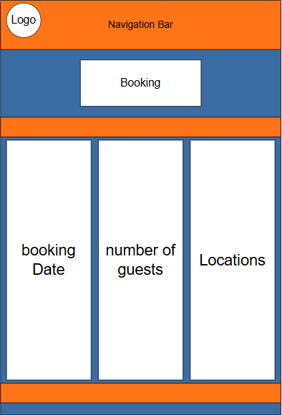
Design Decisions
Design Decisions
Booking Page
I thought that a table-like design would suit the booking page
This is due to the more business/serious oriented nature of having to book the experience instead of the more dynamic and atmospheric feel of the rest of the website.

Slide 17
Design Decisions
Design Decisions
Booking Page
I thought that a table-like design would suit the booking page
This is due to the more business/serious oriented nature of having to book the experience instead of the more dynamic and atmospheric feel of the rest of the website.

Slide 18
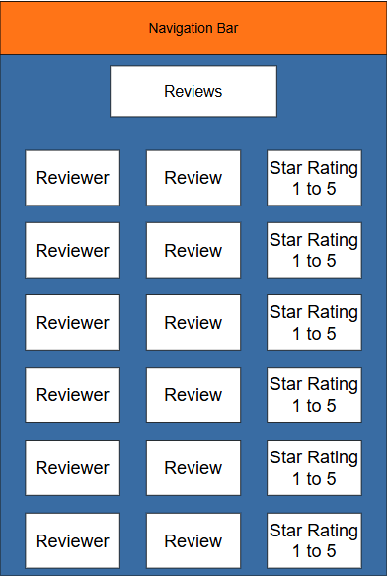
Design Decisions
Review Page
I chose to split the review page into 3 parts, username, description and star rating.
I chose to split the review page into 3 parts, username, description and star rating.

Slide 19
Design Decisions
Review Page
I chose to split the review page into 3 parts, username, description and star rating.
I chose to split the review page into 3 parts, username, description and star rating.

Slide 20
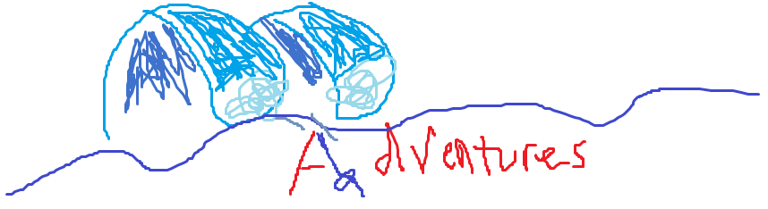
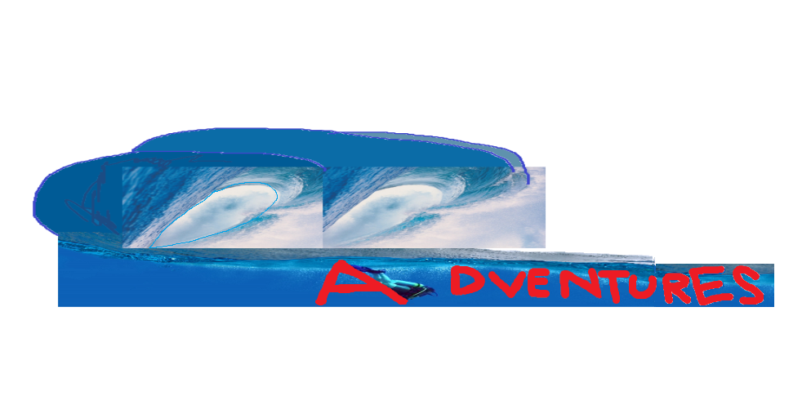
Design Decisions
Devon Dive Adventures
Logo
The logo went through a few changes however this was the final concept.
The 2 waves make the shape of 2 D’s and a diver makes part of the A.

Slide 21
Extra Considerations
Miscellaneous Considerations
The intention behind this was to improve how it looks visually as well as catering towards the possibility of future advertisements running within these areas.
The web page designs have plenty of whitespace along the sides of the pages

Slide 22
Extra Considerations
Miscellaneous Considerations
The intention behind this was to improve how it looks visually as well as catering towards the possibility of future advertisements running within these areas.
The web page designs have plenty of whitespace along the sides of the pages

Slide 23

Extra Considerations
Miscellaneous Considerations
The whitespace could include some small bubbles to make it blend in better with the aquatic environmental feeling of the website.

Slide 24
Extra Considerations
Miscellaneous Considerations
Originally, there was a planned contact page which would show the contact details for Devon Dive Adventures
After some consideration it was decided to make this the footer instead.

Slide 25
Extra Considerations
Miscellaneous Considerations
Originally, there was a planned contact page which would show the contact details for Devon Dive Adventures
After some consideration it was decided to make this the footer instead.

Slide 26
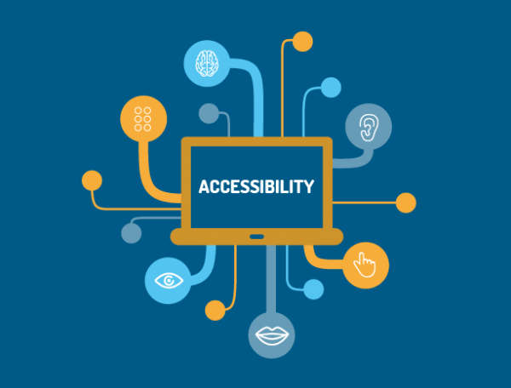
Use of Semantic HTML tags for screen reader compatibility with a clear content hierarchy
Alt-Text embedded into every image featured on the website
Interactive elements will support keyboard navigation e.g Using Tab and Arrow Keys
Use of ARIA to label elements without a Native HTML Tag
Normal text will have a colour contrast ratio of 4.5:1 and Large text being a 3:1 colour contrast ratio.
Notes:
“alt-text” should be embedded into any images featured on the website, ensuring that users with visual accessibility needs can understand and interact with the visual content of the website.
It is imperative that HTML elements such as <header> tags are used, these are important to allow screen readers to interpret the website structure accurate
Interactive elements should support keyboard navigation e.g. using the “Tab” key to select buttons and menus, this makes sure that users with motor accessibility needs can navigate the website efficiently and enjoyably.
Through the use of ARIA (Accessible Rich Internet Applications) the project can allow for improved functionality with accessibility tools by assigning roles e.g. “role = button” within “<div>” tags for improved compatibility with screen readers (W3C, 2014). Sufficient colour

Slide 27
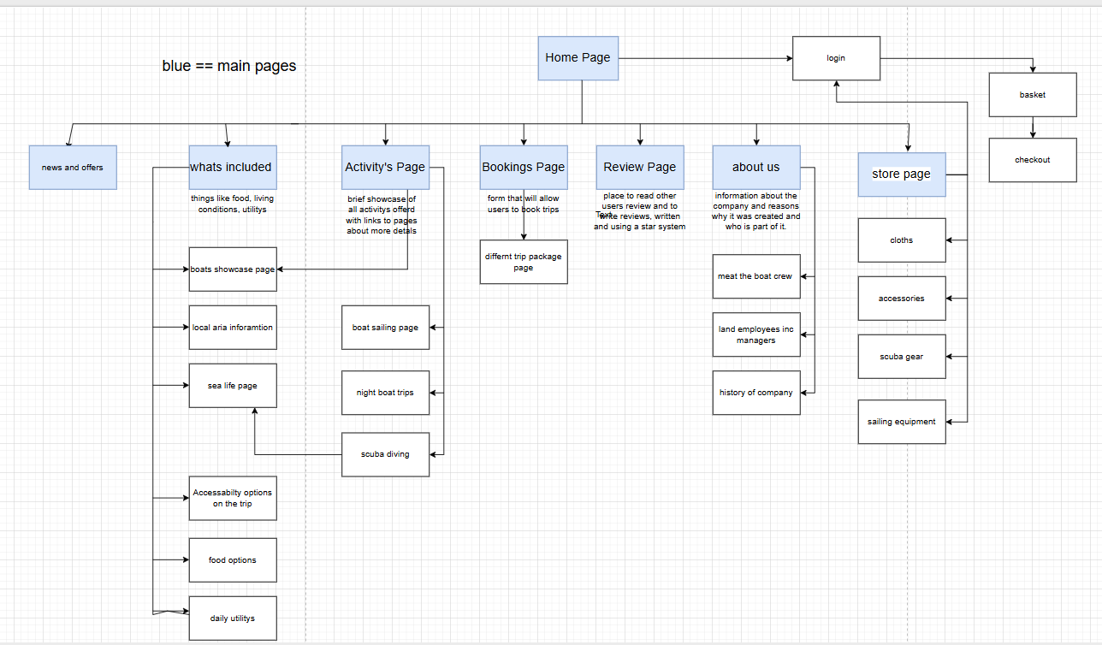
Site map and layout
Design of website

Slide 28
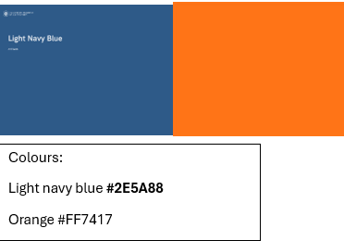
colour scheme
The brief gives the colour scheme blue and orange
we have chosen these shades as they are common on sea related things such as life jackets, buoys, colour of the water.
These two colours still allow text to be readable
This could be a problem if the user is colour blind whoever they can use accessibility options.

Slide 29
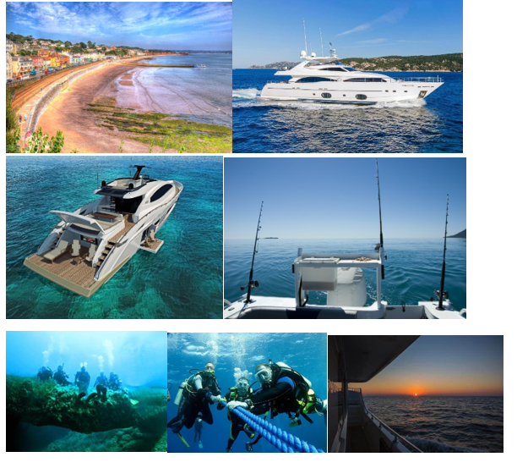
Imagery of the services that devon dive will offer
This gives design inspiration to styles the page in the right theme to satisfy the customer.

Slide 30
Creating a good user experience through design to create a better product

Slide 31
Testing

Slide 32
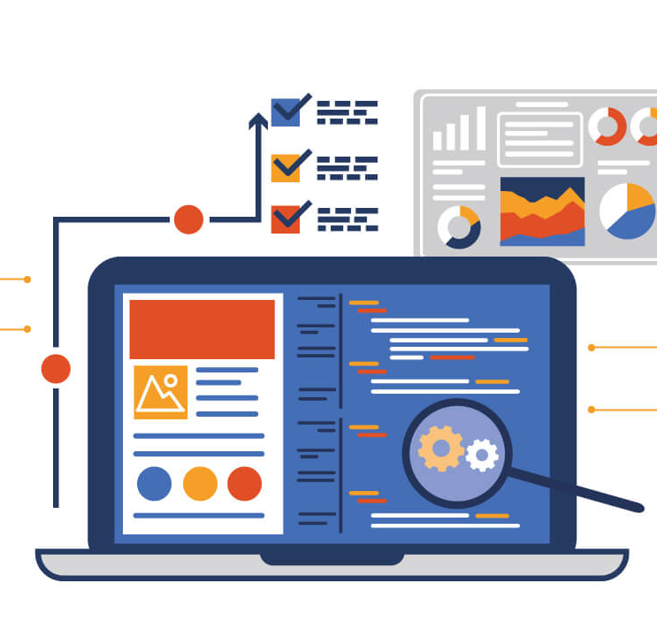
Testing Functionality
Navigation menus and hyperlinks are tested to ensure they lead users to the correct destination upon interaction.
Buttons will be tested to ensure they trigger the correct action such as data submission and opening windows, alongside any correct loading animations where necessary.
All forms and input fields will be tested to ensure proper data and input handling; data validation within data entry fields; correct form submission and back-end processing alongside, any user confirmation and error handling messages.

Slide 33

Testing Compatibility
The website will be tested across all major web browsers such as: Google Chrome, Firefox, Safari and Edge
Compatibility across operating systems such as Windows, macOS, Android and iOS.
Device Compatibility will be tested to ensure the website is consistent across mobile, desktop and tablets.

Slide 34
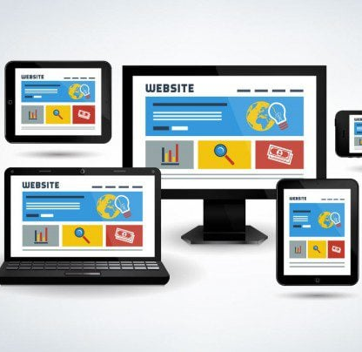
Testing Responsiveness
Resizing the browser windows to observe how the web page reacts to sudden sizing changes; this ensures a seamless user experience across a range of devices.
Developer tools will be used to simulate various screen resolutions to ensure further compatibility with a range of different devices.

Slide 35
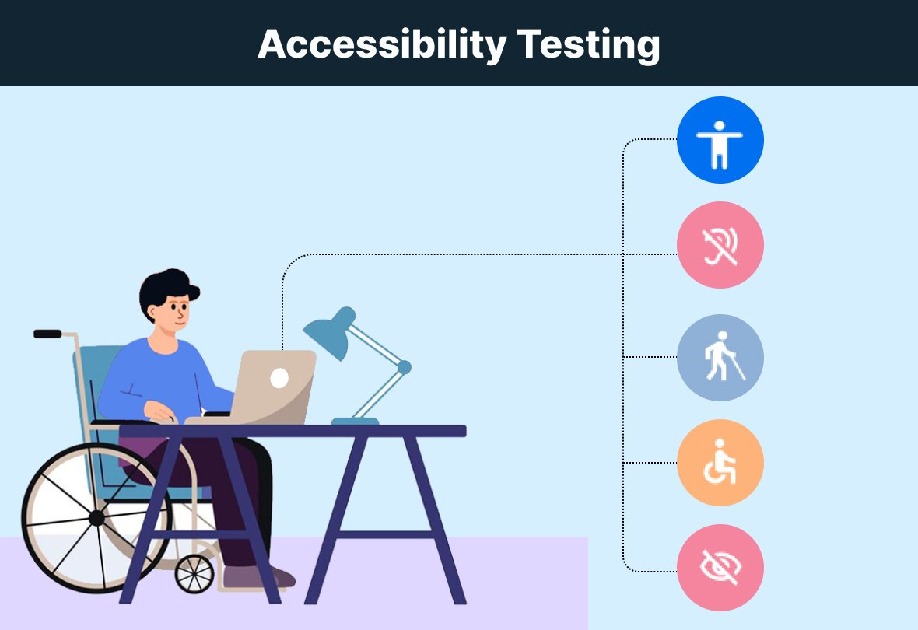
Testing Accessibility
The website will be tested to ensure it follows a clear content hierarchy with tags such as headings (e.g. <h1>, <h2>, <h3> etc.).
Images will be checked and tested using tools such as: NVDA to ensure alt text has been properly embedded within images and WAVE to ensure structure has been maintained.
Keyboard Navigation will be tested manually to ensure it is possible to navigate the website through the exclusive use of the keyboard (e.g. Tab and Arrow Keys).

Slide 36
Launch
Notes:
After the launch of the Devon Dive website, the client may wish to pursue post launch support. Should the company wish to head in this direction this section will outline and propose several options for the website that may be worked upon after the launch.

Slide 37

Launch Guidelines
If an external database has been used security measures should be verified and tested before launch.
The website will be served over HTTPS to ensure the protection of user data and improve user trust.
A complete content review should be done on the website to verify there are no spelling mistakes, grammatical errors or inappropriate content on the web page.
A backup of the website and any external databases will be made and pushed to GitHub to ensure the existence of a recovery point if anything goes wrong.

Slide 38
Post-Launch Support
Technical Troubleshooting, involving assisting the client with any unexpected issues with website performance
Regular Content updates as the Devon Dive brand progresses and wishes to expand
User Feedback analysis, assisting the client with collection of user data/reviews.
Regular Accessibility audits to ensure the website is compliant with the latest Web Content Accessibility Guidelines

Slide 39
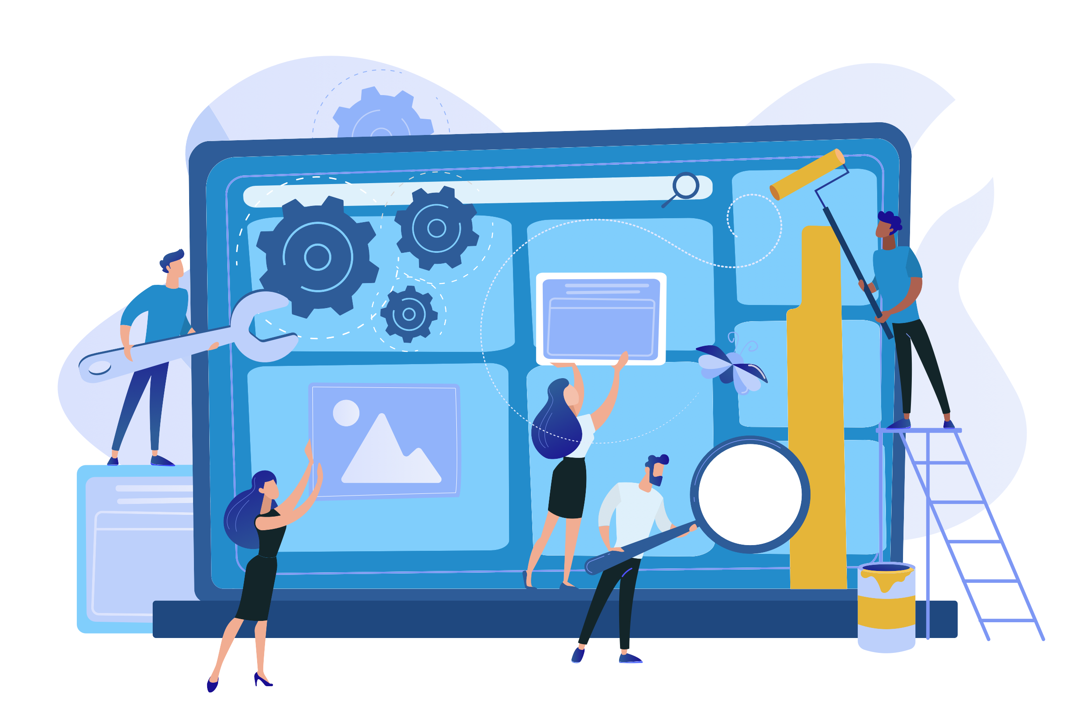
Post-Launch Maintenance
Regularly applying software updates. Keeping libraries up to date alongside any plugins and third part tools.
Regular Security monitoring and patching to prevent data breaches and protection of client information.
User Feedback analysis, assisting the client with collection of user data/reviews.
Schedules backups of site files and information for asset loss prevention
Notes:
Keeping this up to date is imperative to prevent compatibility issues, add new features through post launch content updates and fix bugs.
By ensuring regular necessary security patches and ensuring protections such as firewalls and SSL certificates are always active and up to date the longevity of the website can be increased significantly.
having regular scheduled backups of the site’s files and database potential loss of assets can be prevented in the event of server failure, hacking, or accidental data loss. By having regular back-ups as part of post-launch maintenance the site can be quickly restored to its last backed up state with minimal disruption to up-time.

